Slide 1
Identifying animals in camera trap footage
Project Update - Milestone 2
by Lena Schwertmann
Module: Machine Learning Lab
Examiner: Prof. Ulf Brefeld
Date: January 5, 2020

Slide 2

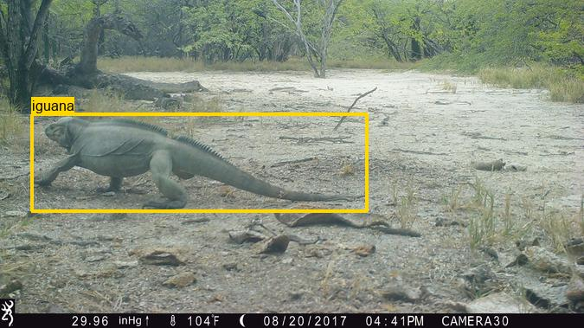
Motivation
→ large-scale camera trap projects create millions of images that are usually manually annotated!
→ automating animal detection is desirable…
… to free up resources for biologists or scale up their studies!
Dominican Republic, Cabritos Island
Notes:
TRACK ABUNDANCY AND DISTRIBUTION OF ANIMALS

Slide 3

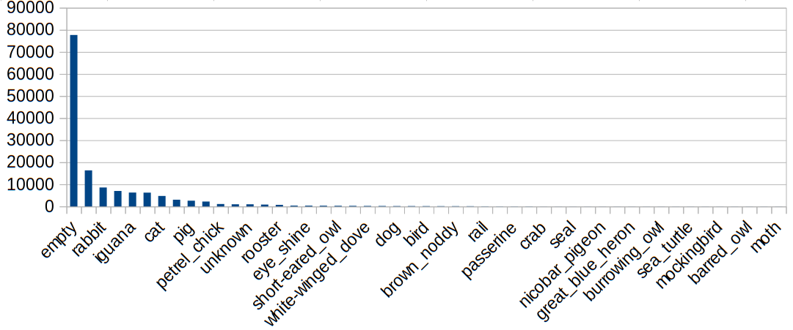
Data
dataset: Island Conservation Dataset (Pacific Ocean & Caribbean)
characteristics: 100 k RGB images, 47 classes, imbalanced
challenges
animals are often only partly visible
high resolution, different sizes
many different landscape types/backgrounds
Notes:
7 islands in 6 countries
10 CLASSES: LAST CLASS HAS 2000 IMAGES
6 CLASSES: LAST CLASS HAS 6000 IMAGES

Slide 4

Baseline & Model
Baseline: always predict majority class
Accuracy is 60% (= empty image)
Image Preprocessing
simple
random crop to smallest image size (1280 x 1024 px)
transform to tensor
normalizing
more complex (data augmentation)
horizontal flipping
more controlled cropping (e.g. using bounding boxes)
grayscale
downscale images to smaller size
Model: Convolutional Neural Networks (CNNs)
ResNet-18 achieved 98% accuracy (3.7 million images, 27 classes, data augmentation when trained from scratch
(Tabak et al., 2018)

Slide 5
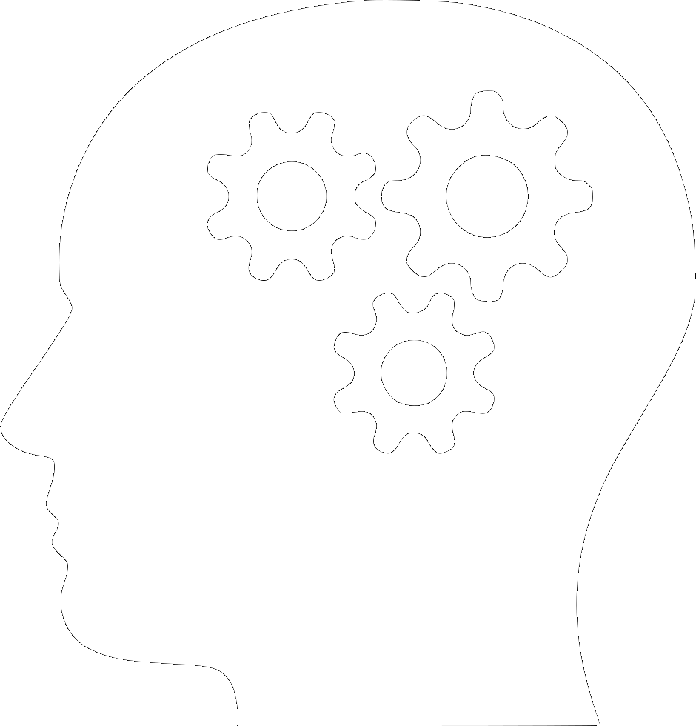
Outlook
select subset of 3-10 most frequent classes
implement/load ResNet-18
implement distributed hyperparameter tuning
small-scale training on my CPU
large-scale training on the university GPUs
Notes:
WHAT AM I CURRENTLY DOING?

Slide 6
